Slide 1

Understanding My Community Through The Social-Ecological Model
By: Mariana Garcia
NURS 317

Slide 2
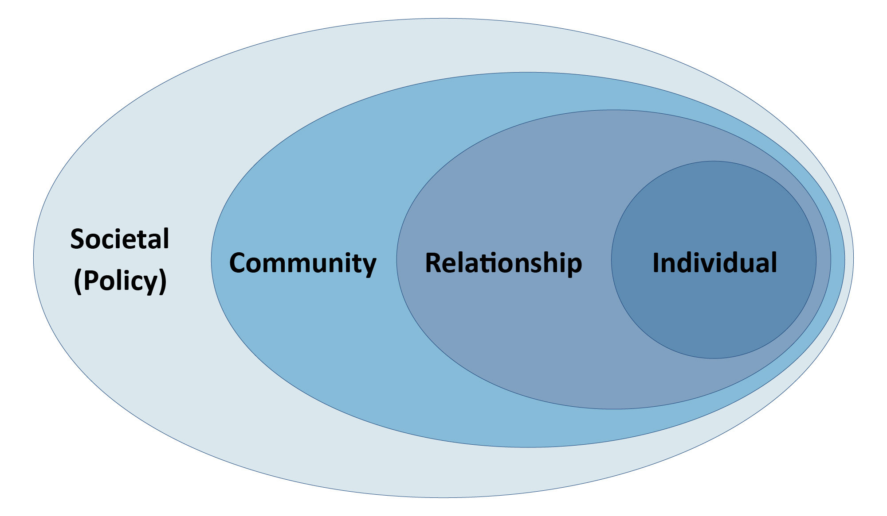
Social Ecological Model

Slide 3
Social Determinants of Health
Healthcare access & Quality
Neighborhood & Built Environment
Health Literacy
Food Security

Slide 4

Emancipatory Knowing
Who benefits?
What is wrong with this picture?
What are the barriers to freedom?
What changes are needed?

Slide 5
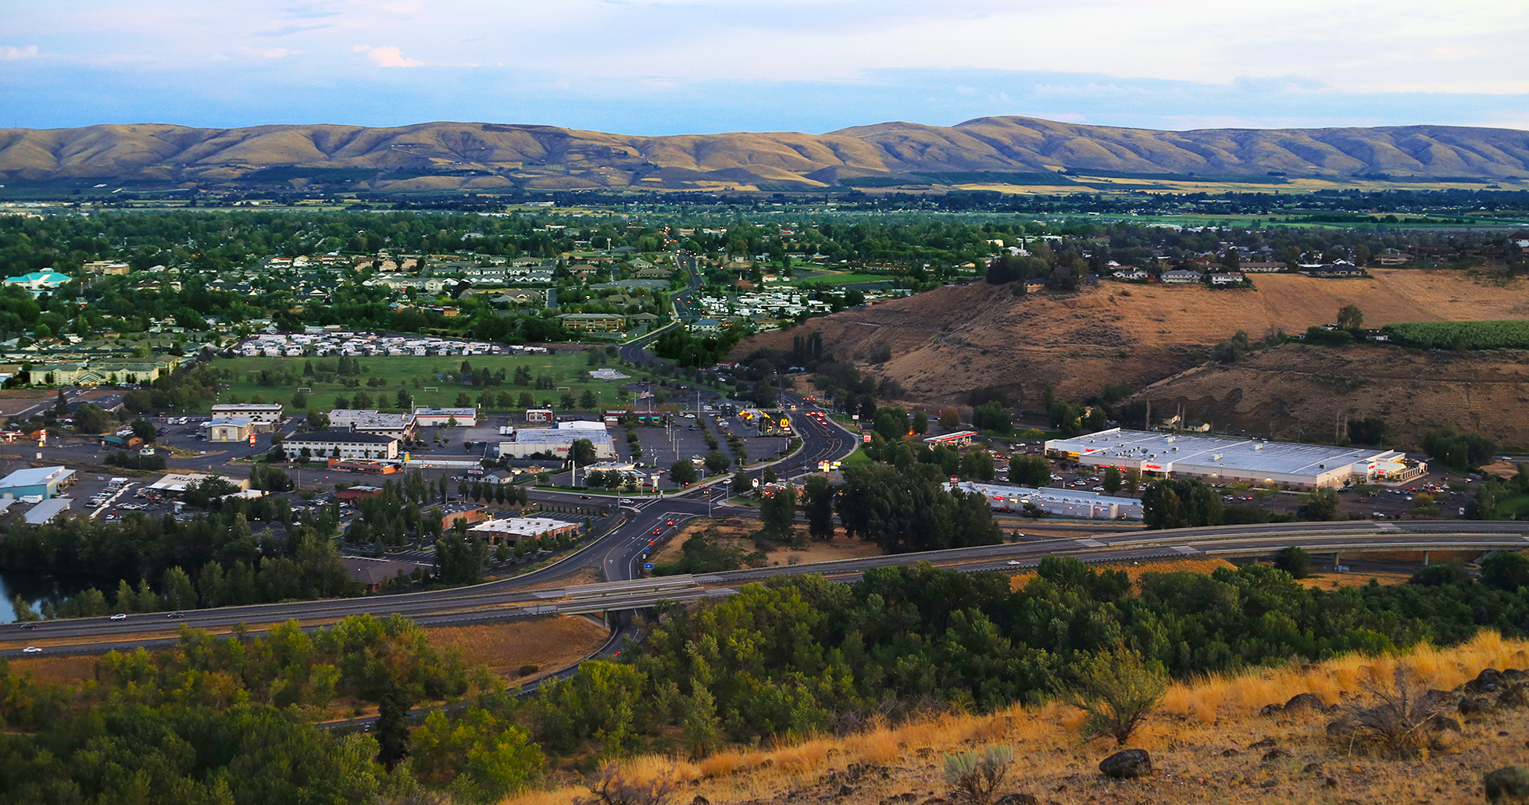
Healthcare Access/Neighborhood & Built Environment

Slide 6
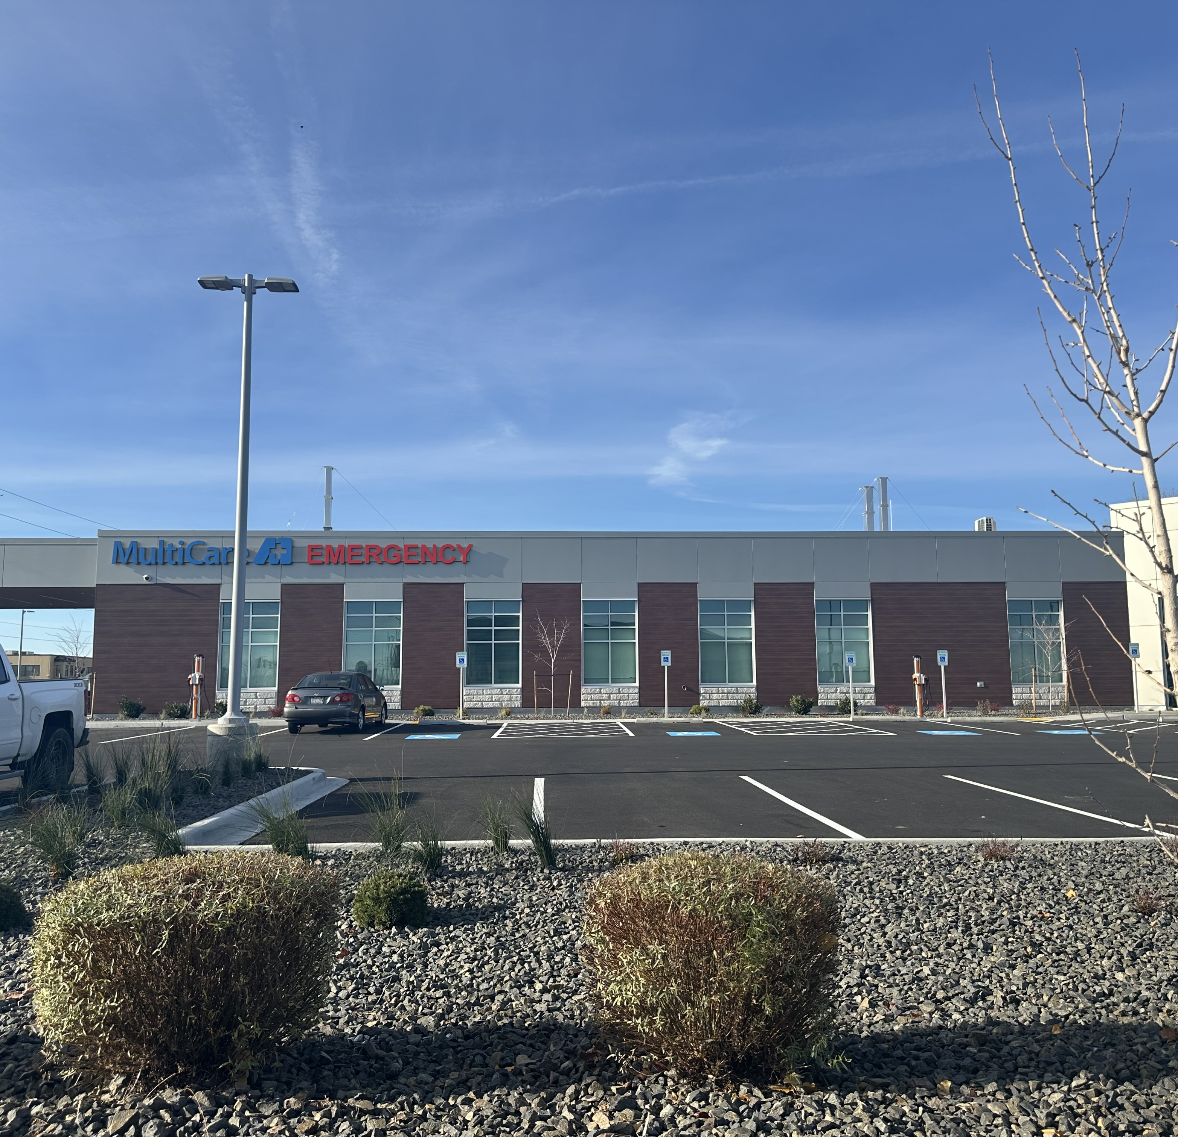
Resilience

Slide 7
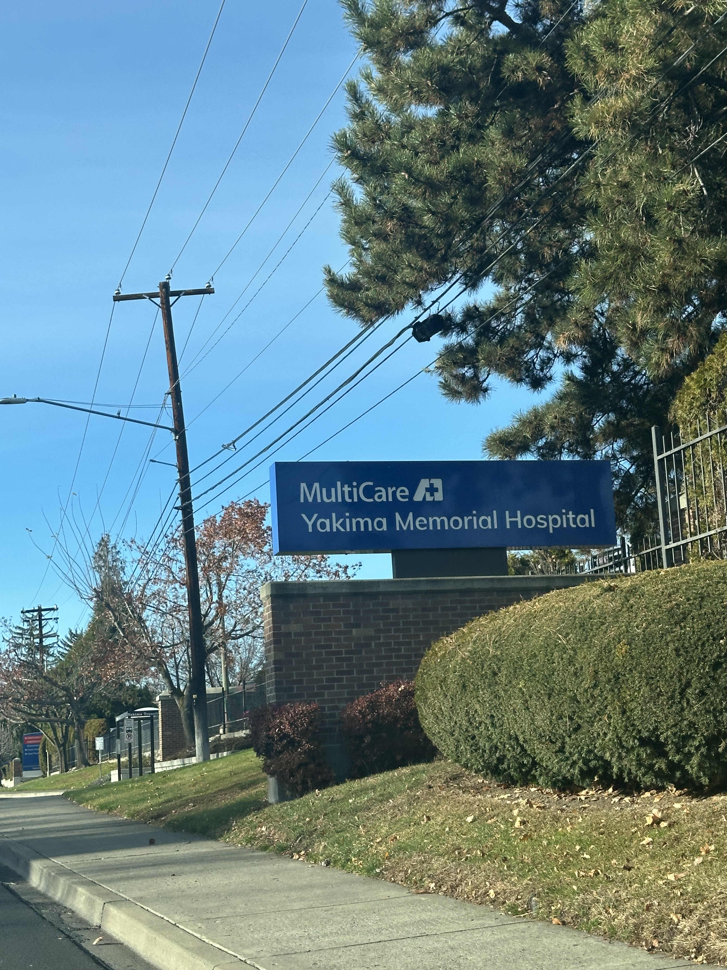
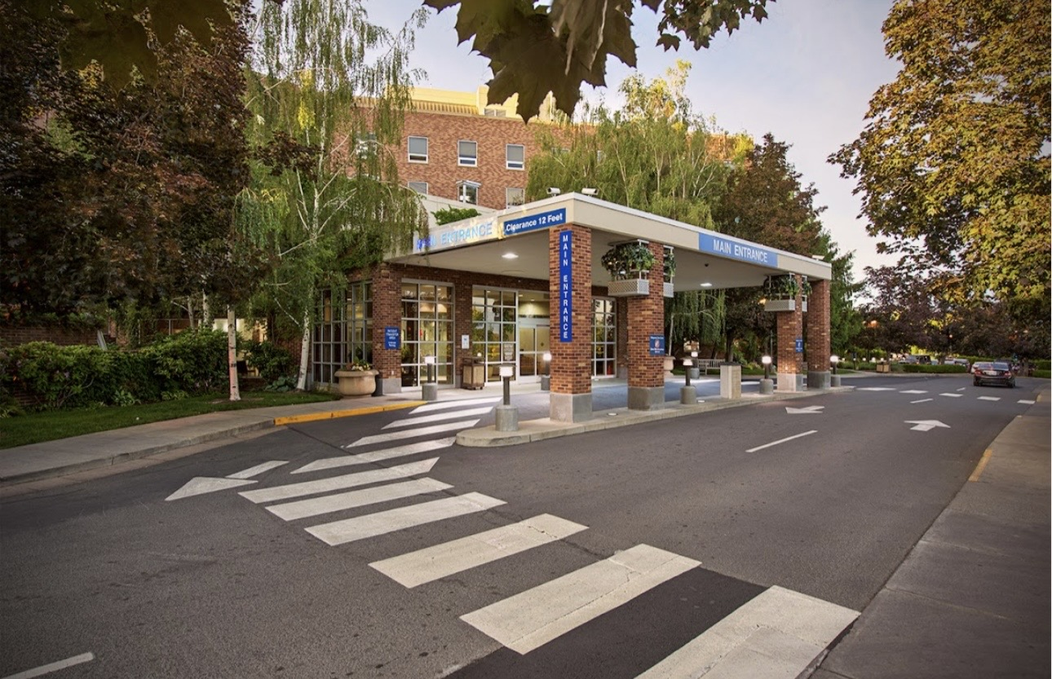
Risk Factor

Slide 8

Health Literacy/Food Security

Slide 9
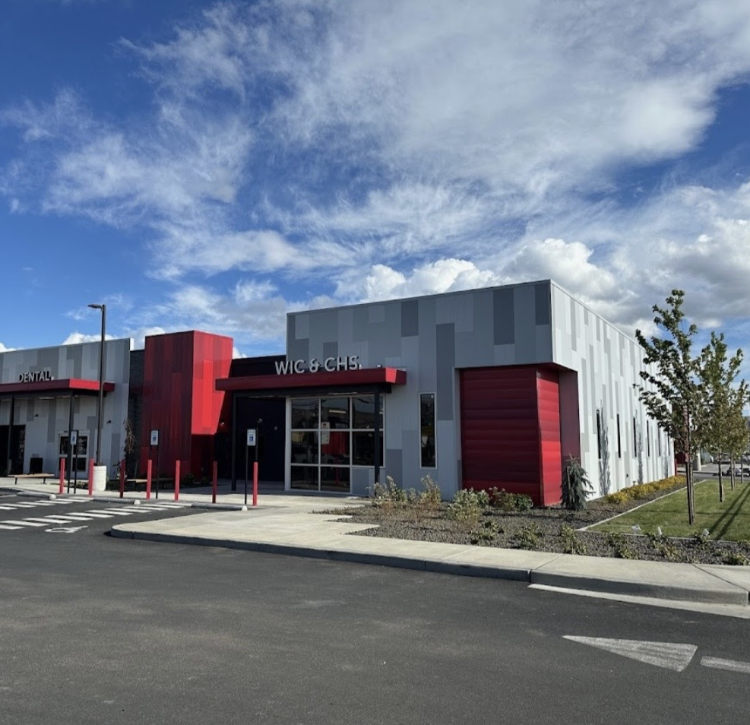
Resilience & Risk
Yakima Farm Workers Clinic

Slide 10
Thank You!

