Slide 1

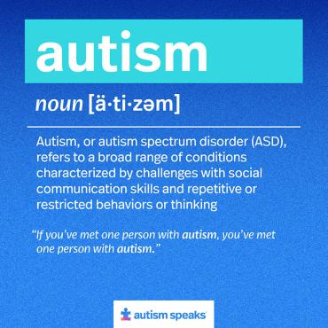
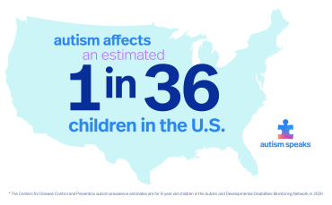

Parental Stress and the Autism Journey
Serenity Benoit, Mariana Garcia, Nikki Grooters, Brooklyn Washburn
Department of Nursing
Parent Training vs. Psychoeducation: Parent training led to greater improvements in competence and stress reduction compared to psychoeducation at 12 weeks.
Parent-Child Quality Time: High parental stress was linked to less quality time and enjoyment in families with children with ASD.
Coping Resources: Self-efficacy and social support lowered stress, while dysfunctional coping increased it. Functional strategies, like seeking support, reduced stress.
Community Resources: Community education programs for newly diagnosed children with ASD reduced stress, increased knowledge, and empowered parents.
Introduction
Autism spectrum disorder (ASD) is a developmental disorder that affects approximately 1 in 36 children in the U.S. This presents significant challenges for families. Parents of children with ASD often experience higher levels of stress, which can negatively impact their mental and physical well-being. Frequent common barriers are:
Emotional strain
Social isolation
Lack of support
Need for self-care
Lack of resources
Results
Case Study
A family of 5 (father, mother, and three children) is having barriers in accessing care for managing autism. They experience a long journey of finding the right doctor to get an autism diagnosis and additional testing which causes frustration and stress for this family. The mom knew something was different about her daughter but finding a medical provider to listen to her was hard. External family is supportive but not local, and it is hard to find help with care when needed, causing caregiver strain. The family finds it a challenge to find respite care for their child, as there aren't many health care professionals specializing in autism in their area.
Methods
A CINAHL database advanced search was used.
Key words: family, autism, stress
Full text peer reviewed articles from 2010-2024
4/84 articles used for our research .
Ecomap
.
School
Immediate family
Purpose
The purpose of this project is to examine the barriers families face when caring for a child diagnosed with autism and to explore how participation in support groups and educational resources can reduce parental stress. By identifying effective interventions, this project aims to guide nursing practices that support families in managing the challenges of the autism journey.
Friends
Community
Conclusion
Child with ASD
Spiritual
Families of children with ASD experience emotional strain and social isolation.
Parent training and community support can reduce stress.
Accessible resources are urgently needed for families.
Empowering parents by addressing these barriers improves family dynamics and benefits children with ASD.
Enhancing nursing practices and support ensures families receive the help they need..
Health care providers
Extended family
Nursing Actions
Help families make SMART goals on self-care.
Help look for support groups or resources.
Help get a referral to family or individual counselling.
Help explore alternative therapies.
Identify what symptoms interfere with daily functioning of life.
References

